Slide 1



Digital
Games
Game Design - 201
Tue 2-4:45pm C-356
Prof. A McClure

Slide 2
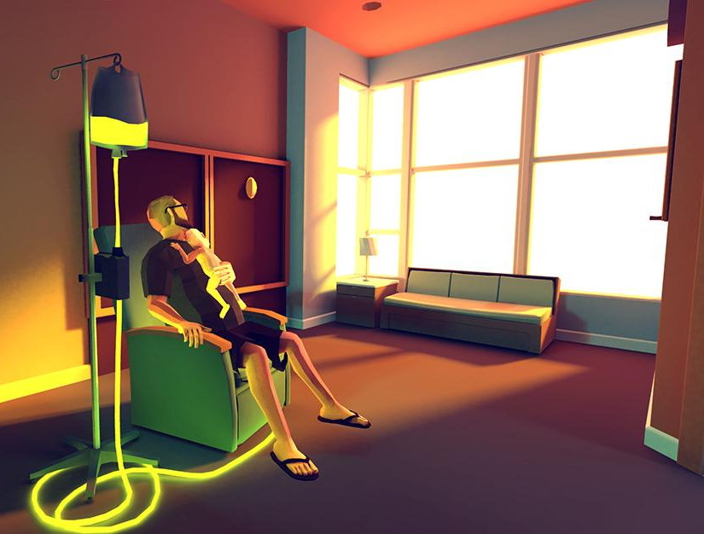
EVENT
NYPLarcade link
Feb 23rd - That Dragon, Cancer
March 29th - The Witness
Jefferson Market Library in Greenwich Village
6-7:30PM
3 points of extra credit for attending, playing the game, and writing a post describing your experience with photos.

Slide 3
EVENT
Playcrafting Demo and Play Night link
$8 + $1.43 early price covers admission and pizza
held at Tumblr in Flatiron
3 points of extra credit for attending, interviewing 2 demo participants and detailing the interaction in a post
2 additional points if you submit your own game for future consideration, but you must also attend this one

Slide 4
Download and install Game Maker if you haven’t already…
Game Maker Studio Lite (Windows)
Game Maker for Mac Lite (OS X)
Start exploring and experimenting in the application.

Slide 5
PREVIOUS HOMEWORK PLAY
PREVIOUS HOMEWORK RGR2 (500 word minimum)
Cookie Clicker by Orteil (Julien Thiennot)
play for at least 4 hours (including idle time)
Read Numbers Getting Bigger by Alexander King
Write a thoughtful response to your experience with Cookie Clicker and other incremental/idle games.
Some things to think about…
Should games be fun?
Would this work as an analog game?
What are some more well known games that use similar design strategies?
How can this inform your own design practice?
Are clicking games evil?

Slide 6
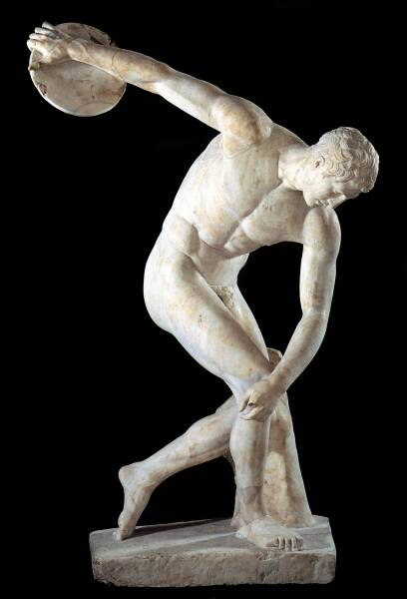
DISCUS

Slide 7
Warm seat discussions!
wait, what?

Slide 8
Half the class moves to the next seat every 2 minutes!

Slide 9
2 minutes each
What was your experience playing Cookie Clicker? How long did you play?
What recent games does this make you think of?
Was it fun? Does that matter?
Should games be this way?
Are there any retro games that use similar mechanics?
Do you like cookies?

Slide 10
fun vs. rewarding

Slide 11
wtf is a gdd?

Slide 12
A game design document (often abbreviated GDD) is a highly descriptive living design document of the design for a video game. A GDD is created and edited by the development team and it is primarily used in the video game industry to organize efforts within a development team.

Slide 13
One Sheet vs. Full GDD

Slide 14
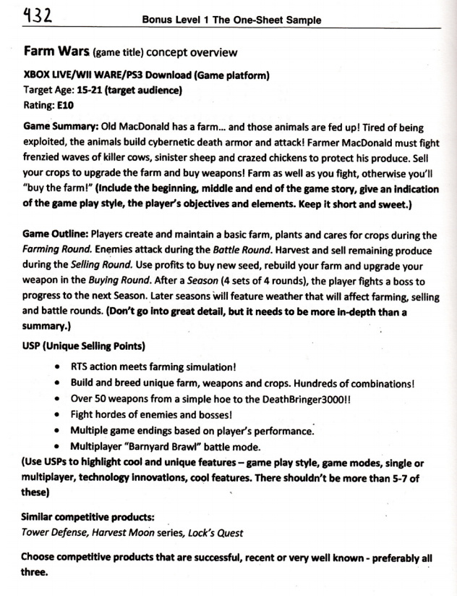
One-Sheet Example
link

Slide 15
One-Sheet Outline
Title
Game Platform
Target Audience
Rating
Game Summary
Game Outline
USP (Unique Selling Points)
Similar Competitive Products / Precedents

Slide 16
Game Design Document Resources
http://www.gamasutra.com/view/feature/131632/creating_a_great_design_document.php
http://www.gamasutra.com/view/feature/131791/the_anatomy_of_a_design_document_.php?page=1

Slide 17
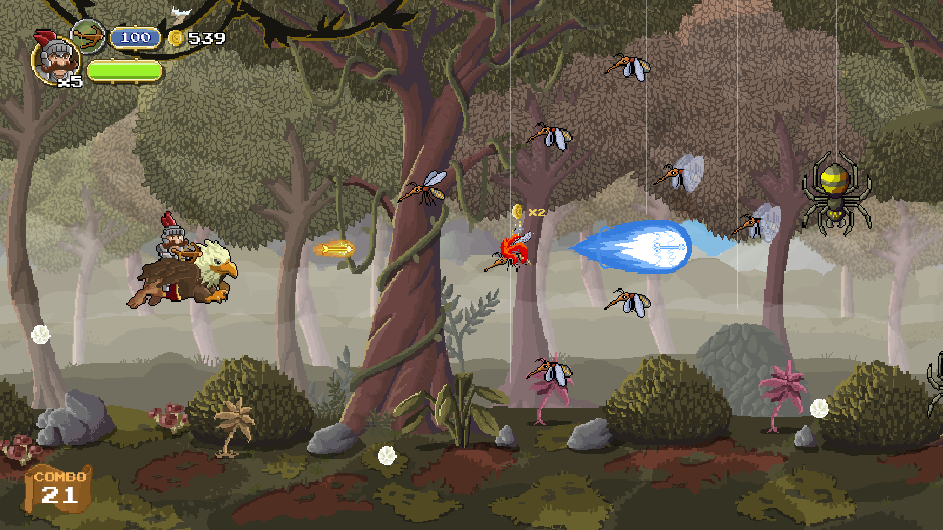
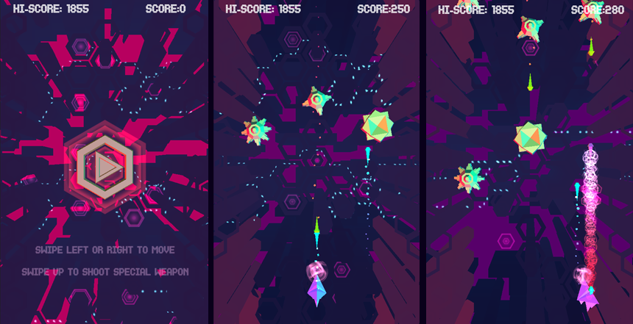
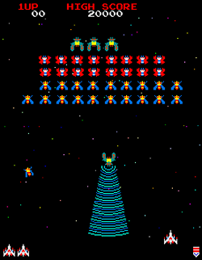
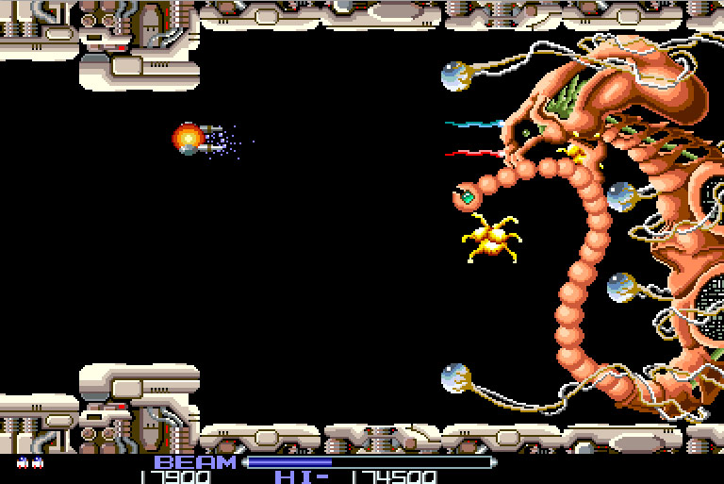
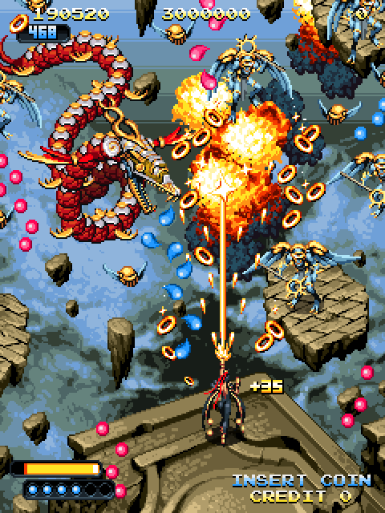
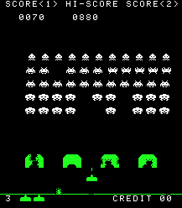
Notes:
what do these have in common?
-on rails
-projectiles

Slide 18
Formally Defined
Shoot 'em up (also known as shmup or STG) is a subgenre of the shooter genre of video games. In a shoot 'em up, the player character engages in a lone assault, often in a spacecraft or aircraft, shooting large numbers of enemies while dodging their attacks. There is no consensus as to which design elements compose a shoot 'em up. Some restrict the definition to games featuring spacecraft and certain types of character movement; others allow a broader definition including characters on foot and a variety of perspectives. Shoot 'em ups call for fast reactions and for the player to memorize levels and enemy attack patterns. "Bullet hell" games feature overwhelming numbers of enemy projectiles.

Slide 19
The genre's origins can be traced back to Spacewar!, one of the very earliest computer games, developed in 1961 and eventually released in amusement arcades in the early 1970s. However, Tomohiro Nishikado, creator of Space Invaders, is generally credited with inventing the genre. Space Invaders premiered in Japanese arcades in 1978. Shoot 'em ups were popular throughout the 1980s and early 1990s.

Slide 20





Informal Requirements for GD201
The use of projectiles, speed and accuracy as the core game mechanics.
How that happens is up to you!

Slide 21
the catch...
wut

Slide 22
design constraint:
Projectiles must not be weapons.
Notes:
violence is a boring default

Slide 23

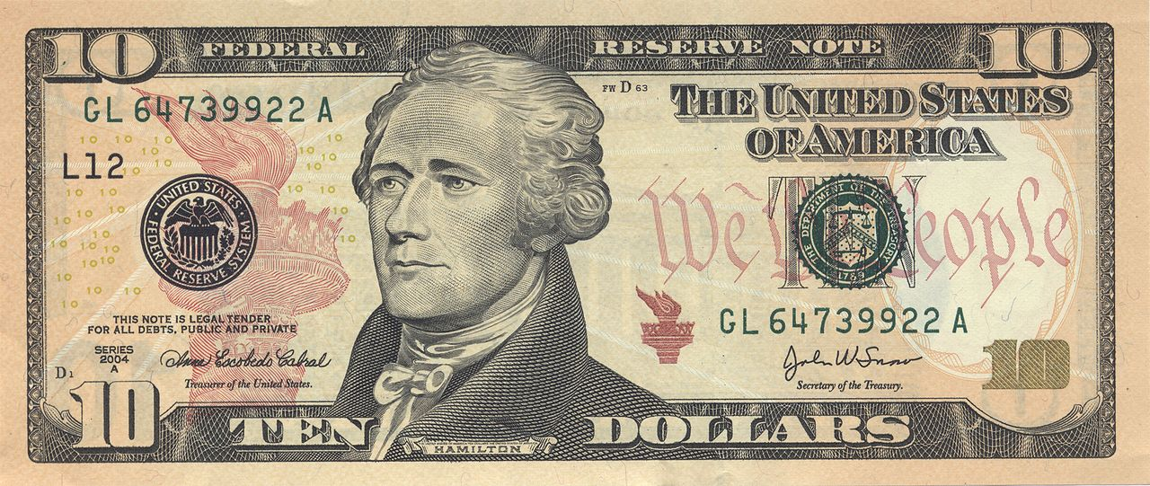

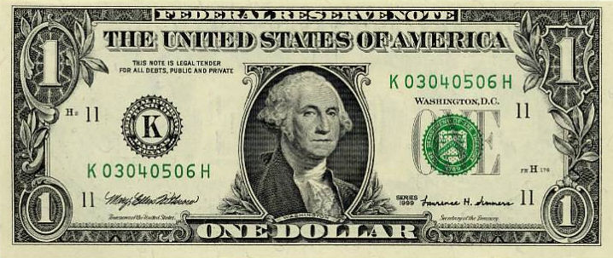


Notes:
sending food to hungry children before they die
planting trees upon the earth at the right destinations

Slide 24
Game Pitch Expectations
Short presentation outlining your game proposal (based on your one-sheet)
(5-10 minutes -- slideshow presentation is ok)
Class will pose questions and critique your team’s concept.
Take these under advisement

Slide 25
Game Pitch Expectations
One-sheet document *printed out* and distributed to the class at the beginning of the presentation
Your one-sheet will continue to be used and updated during the design process

Slide 26
When is all of this due?
Game pitches -- Week 5 (3/8/16)
Final games ready to play/Presentations Week 8 (3/29/16)

Slide 27

Breaking into teams
http://goo.gl/forms/IZcMkE2PNG
Excuse me folks, I need you to fill out this form.

Slide 28
http://goo.gl/forms/IZcMkE2PNG
28 students
8 teams of 3
2 teams of 2

Slide 29
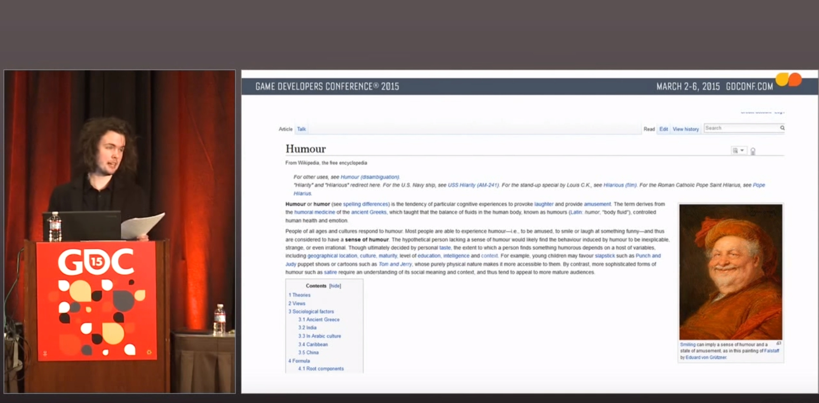

Slide 30


Slide 31
HOMEWORK
PLAY Increpare’s Slave of God seizure warning!!
READ Art Games chapter from Works of Game (Sharp)
READ Rock Paper Shotgun - Photorealism is Crucial
READ Video Games Can Never be Art (Roger Ebert)
WRITE RGR3 (500 word minimum)
What is your reaction to Slave of God?
Can games be art?
Do pretty graphics matter?
Should games be realistic?
etc.

